Slide 1
Python 3.6
Harun al rasyid – 5b417822

Slide 2
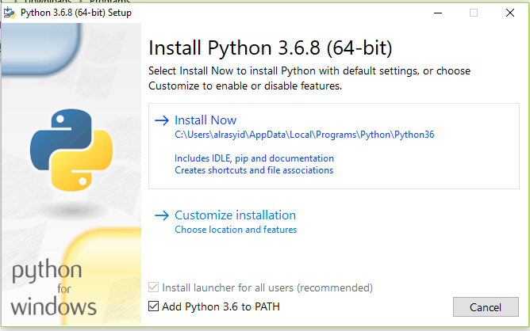
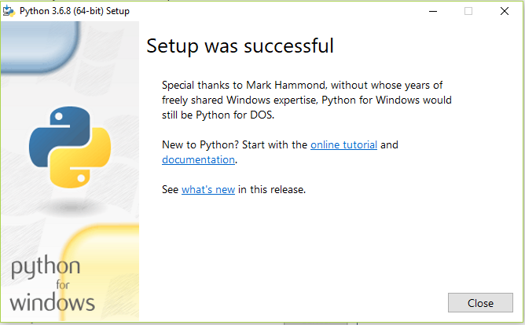
Instalasi

Slide 3

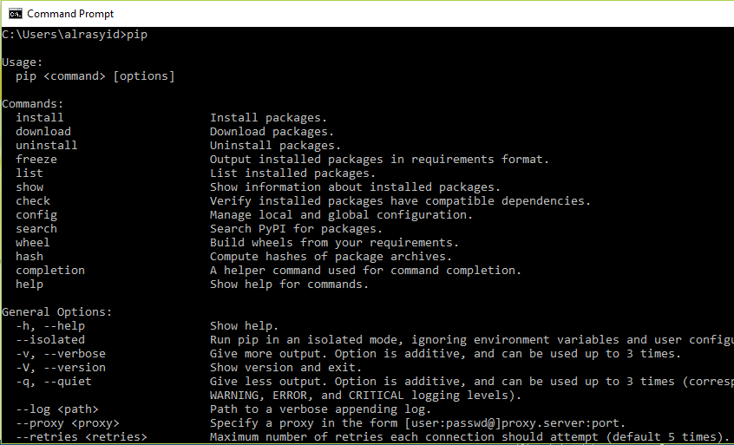

Slide 4
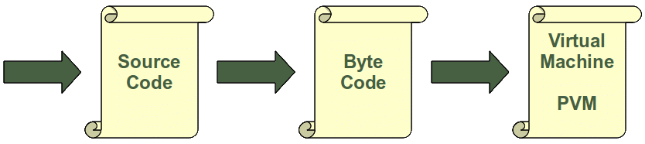
Differences between Compilers and Interpreters
Compiler
A compiler is a computer program that transforms (translates) source code of a programming language (the source language) into another computer language (the target language). In most cases compilers are used to transform source code into executable program, i.e. they translate code from high-level programming languages into low (or lower) level languages, mostly assembly or machine code.
Interpreter
An interpreter is a computer program that executes instructions written in a programming language. It can either
• execute the source code directly or
• translates the source code in a first step into a more efficient representation and executes this code
Every time a Python script is executed, byte code is created. If a Python script is imported as a module, the byte code will be stored in the corresponding .pyc file.

Slide 5
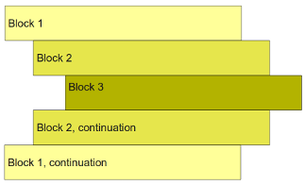
Blocks
A block is a group of statements in a program or script. Usually it consists of at least one statement and of declarations for the block, depending on the programming or scripting language. A language, which allows grouping with blocks, is called a block structured language.
Python uses a different principle. Python programs get structured through indentation, i.e. code blocks are defined by their indentation.

Slide 6
Variable in python
There is no declaration of variables required in Python. It's not even possible. If there is need of a variable, you think of a name and start using it as a variable. Not only the value of a variable may change during program execution but the type as well.
As we have said above, the type of a variable can change during the execution of a script. Or to be precise: A new object, which can be of any type, will be assigned to it. We illustrate this in our following example:
i = 42 # data type is implicitly set to integer
i = 42 + 0.11 # data type is changed to float
i = "forty" # and now it will be a string

Slide 7
A variable name and an identifier can consist of the uppercase letters "A" through "Z", the lowercase letters "a" through "z" , the underscore _ and, except for the first character, the digits 0 through 9. Python 3.x is based on Unicode. This means that variable names and identifier names can additionally contain Unicode characters as well. Identifiers are unlimited in length. Case is significant.
No identifier can have the same name as one of the Python keywords, although they are obeying the above naming conventions:
and, as, assert, break, class, continue, def, del, elif, else,
except, False, finally, for, from, global, if, import, in, is,
lambda, None, nonlocal, not, or, pass, raise, return, True, try,
while, with, yield

Slide 8
Numbers
Hexadecimal literals (base 16) Hexadecimal literals have to be prefixed either by "0x" or "0X". example: >>> hex_number = 0xA0F >>> print(hex_number) 2575
Binary literals (base 2) Binary literals can easily be written as well. They have to be prefixed by a leading "0", followed by a "b" or "B": >>> x = 0b101010 >>> x 42 >>>
Floating-point numbers for example: 42.11, 3.1415e-10
Complex numbers Complex numbers are written as <real part> + <imaginary part>j examples: >>> x = 3 + 4j >>> y = 2 - 3j >>> z = x + y >>> print(z) (5+1j)
Python's built-in core data types are in some cases also called object types. There are four built-in data types for numbers:
Integer
Normal integers e.g. 4321
Octal literals (base 8) A number prefixed by 0o (zero and a lowercase "o" or uppercase "O") will be interpreted as an octal number example: >>> a = 0o10 >>> print(a) 8

Slide 9
String
There are different ways to define strings in Python:
>>> s = 'I am a string enclosed in single quotes.'
>>> s2 = "I am another string, but I am enclosed in double quotes"
Both s and s2 of the previous example are variables referencing string objects. We can see, that string literals can either be enclosed in matching single (') or in double quotes ("). Single quotes will have to be escaped with a backslash (\), if the string is defined with single quotes:
>>> s3 = 'It doesn\'t matter!'
This is not necessary, if the string is represented by double quotes:
>>> s3 = "It doesn't matter!"
Analogously, we will have to escape a double quote inside a double quoted string:
>>> txt = "He said: \"It doesn't matter, if you enclose a string in single or double quotes!\""
>>> print(txt)
He said: "It doesn't matter, if you enclose a string in single or double quotes!"
>>>
They can also be enclosed in matching groups of three single or double quotes. In this case they are called triple-quoted strings. The backslash (\) character is used to escape characters that otherwise have a special meaning, such as newline, backslash itself, or the quote character.
txt = '''A string in triple quotes can extend
over multiple lines like this one, and can contain
'single' and "double" quotes.'''

Slide 10
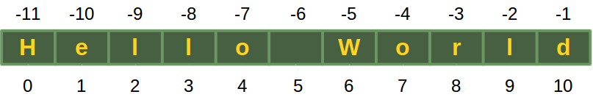
A string in Python consists of a series or sequence of characters - letters, numbers, and special characters. Strings can be subscripted or indexed. Similar to C, the first character of a string has the index 0.
>>> s = "Hello World"
>>> s[0]
'H'
>>> s[5]
' '
>>>
The last character of a string can be accessed like this:
>>> s[len(s)-1]
'd'
Yet, there is an easier way in Python. The last character can be accessed with -1, the second to last with -2 and so on:
>>> s[-1]
'd'
>>> s[-2]
'l'
>>>

Slide 11
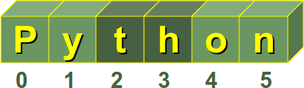
Some operators and functions for strings
Concatenation Strings can be glued together (concatenated) with the + operator: "Hello" + "World" will result in "HelloWorld"
Repetition String can be repeated or repeatedly concatenated with the asterisk operator "*": "*-*" * 3 will result in "*-**-**-*"
Indexing "Python"[0] will result in "P"
Slicing Substrings can be created with the slice or slicing notation, i.e. two indices in square brackets separated by a colon: "Python"[2:4] will result in "th"
Size len("Python") will result in 6

Slide 12
Operators
Operator | Description | Example
+, - | Addition, Subtraction | 10 -3
*, % | Multiplication, Modulo | 27 % 7 Result: 6
/ | Division This operation results in different results for Python 2.x (like floor division) and Python 3.x | Python3: >>> 10 / 3 3.3333333333333335
+x, -x | Unary minus and Unary plus (Algebraic signs) | -3
~x | Bitwise negation | ~3 - 4 Result: -8
** | Exponentiation | 10 ** 3 Result: 1000

Slide 13
Operator | Description | Example
// | Truncation Division (also known as floordivision or floor division) The result of this division is the integral part of the result, i.e. the fractional part is truncated, if there is any. It works both for integers and floating-point numbers, but there is a difference in the type of the results: If both the divident and the divisor are integers, the result will be also an integer. If either the divident or the divisor is a float, the result will be the truncated result as a float. | >>> 10 // 3 3 If at least one of the operands is a float value, we get a truncated float value as the result. >>> 10.0 // 3 3.0 >>> A note about efficiency: The results of int(10 / 3) and 10 // 3 are equal. But the "//" division is more than two times as fast! You can see this here: In [9]: %%timeit for x in range(1, 100): y = int(100 / x) ...: 100000 loops, best of 3: 11.1 μs per loop In [10]: %%timeit for x in range(1, 100): y = 100 // x ....: 100000 loops, best of 3: 4.48 μs per loop

Slide 14
Operator | Description | Example
or, and, not | Boolean Or, Boolean And, Boolean Not | (a or b) and c
in | "Element of" | 1 in [3, 2, 1]
<, <=, >, >=, !=, == | The usual comparison operators | 2 <= 3
|, &, ^ | Bitwise Or, Bitwise And, Bitwise XOR | 6 ^ 3
<<, >> | Shift Operators

Slide 15
Sequential Data Types
Sequences are one of the principal built-in data types besides numerics, mappings, files, instances and exceptions. Python provides for six sequence (or sequential) data types:
strings
byte sequences
byte arrays
lists
tuples
range objects
Strings, lists, tuples, bytes and range objects may look like utterly different things, but nevertheless they have some underlying concepts in common:
The items or elements of strings, lists and tuples are ordered in a defined sequence. The elements can be accessed via indices
>>> text = "Lists and Strings can be accessed via indices!"
>>> print(text[0], text[10], text[-1])
L S !
>>>

Slide 16
List Notation and Examples
List objects are enclosed by square brackets and separated by commas. The following table contains some examples of lists:
List | Description
[] | An empty list
[1,1,2,3,5,8] | A list of integers
[42, "What's the question?", 3.1415] | A list of mixed data types
["Stuttgart", "Freiburg", "München", "Nürnberg", "Würzburg", "Ulm","Friedrichshafen", Zürich", "Wien"] | A list of Strings
[["London","England", 7556900], ["Paris","France",2193031], ["Bern", "Switzerland", 123466]] | A nested list
["High up", ["further down", ["and down", ["deep down", "the answer", 42]]]] | A deeply nested list

Slide 17
Tuples
A tuple is an immutable list, i.e. a tuple cannot be changed in any way once it has been created. A tuple is defined analogously to lists, except that the set of elements is enclosed in parentheses instead of square brackets. The rules for indices are the same as for lists. Once a tuple has been created, you can't add elements to a tuple or remove elements from a tuple. Where is the benefit of tuples?
Tuples are faster than lists.
If you know that some data doesn't have to be changed, you should use tuples instead of lists, because this protects your data against accidental changes.
The main advantage of tuples consists in the fact that tuples can be used as keys in dictionaries, while lists can't.

Slide 18
Dictionaries
Dictionaries are the Python implementation of an abstract data type, known in computer science as an associative array. Associative arrays consist - like dictionaries of (key, value) pairs, such that each possible key appears at most once in the collection. Any key of the dictionary is associated (or mapped) to a value. The values of a dictionary can be any Python data type. So dictionaries are unordered key-value-pairs. Dictionaries are implemented as hash tables, and that is the reason why they are known as "Hashes" in the programming language Perl. Dictionaries don't support the sequence operation of the sequence data types like strings, tuples and lists. Dictionaries belong to the built-in mapping type.

Slide 19
Examples of Dictionaries
>>> city_population = {"New York City":8550405, "Los Angeles":3971883, "Toronto":2731571, "Chicago":2720546, "Houston":2296224, "Montreal":1704694, "Calgary":1239220, "Vancouver":631486, "Boston":667137}
If we want to get the population of one of those cities, all we have to do is to use the name of the city as an index:
>>> city_population["New York City"]
8550405
>>> city_population["Toronto"]
2731571
>>> city_population["Boston"]
667137
It is very easy to add another entry to an existing dictionary:
>>> city_population["Halifax"] = 390096
>>> city_population
{'Toronto': 2615060, 'Ottawa': 883391, 'Los Angeles': 3792621, 'Chicago': 2695598, 'New York City': 8175133, 'Halifax': 390096, 'Boston': 62600, 'Washington': 632323, 'Montreal': 11854442}

Slide 20
Operators on Dictionaries
Operator | Explanation
len(d) | returns the number of stored entries, i.e. the number of (key,value) pairs.
del d[k] | deletes the key k together with his value
k in d | True, if a key k exists in the dictionary d
k not in d | True, if a key k doesn't exist in the dictionary d

Slide 21
Blocks and Indentations
The concept of block building is also known in natural languages, as we can deduce from the following text:
If it rains tomorrow, I will tidy up the cellar. After this I will paint the walls. If there is some time left, I will do my tax declaration. Otherwise, I will go swimming. In the evening, I will go to the cinema with my wife!
If it rains tomorrow, I will do the following:
- tidy up the cellar
- paint the walls
- If there is some time left, I will
- do my tax declaration
Otherwise, I will do the following:
- go swimming
go to the cinema with my wife in the evening

Slide 22
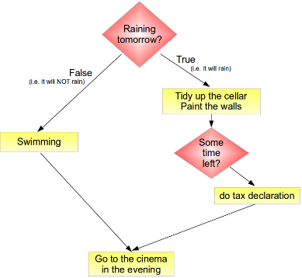
Such a work flow is often formulated in the programming environment as a so-called flow chart or programming flowchart:
Blocks are used in programming to enable groups of statements to be seen or treated as if they were one statement. A block consists of one or more statements. A program can be seen as a block, which consists of statements and other nested blocks.
The example above may look in a Python program like this:
if raining_tomorrow:
tidy_up_the_cellar()
paint_the_walls()
if time_left:
do_taxes()
else:
enjoy_swimming()
go_cinema()

Slide 23
Conditional Statements in Python
As we have already stated, the if-statements are used to change the flow of control in a Python program. This makes it possible to decide at run-time whether or not to run one block of code or another. The simplest form of an if statement in Python looks like this:
if condition:
statement
statement
# ... some more indented statements if necessary
The indented block of code is executed only if the condition "condition" is evaluated to True, meaning that it is logically true.

Slide 24
The general form of the if statement in Python looks like this:
if condition_1:
statement_block_1
elif condition_2:
statement_block_2
...
elif another_condition:
another_statement_block
else:
else_block
If the condition "condition_1" is True, the statements of the block statement_block_1 will be executed. If not, condition_2 will be evaluated. If condition_2 evaluates to True, statement_block_2 will be executed, if condition_2 is False, the other conditions of the following elif conditions will be checked, and finally if none of them has been evaluated to True, the indented block below the else keyword will be executed.

Slide 25
True or False
Unfortunately it is not as easy in real life as it is in Python to differentiate between true and false: The following objects are evaluated by Python as False:
numerical zero values (0, 0.0, 0.0+0.0j),
the Boolean value False,
empty strings,
empty lists and empty tuples,
empty dictionaries.
plus the special value None.
All other values are considered to be True.

Slide 26
Loops
Essentially, there are three different kinds of loops:
Count-controlled loops A construction for repeating a loop a certain number of times. An example of this kind of loop is the for-loop of the programming language C: for (i=0; i <= n; i++) Python doesn't know this kind of loop.
Condition-controlled loop A loop will be repeated until a given condition changes, i.e. changes from True to False or from False to True, depending on the kind of loop. There are while loops and do while loops with this behaviour.
Collection-controlled loop This is a special construct which allow looping through the elements of a "collection", which can be an array, list or other ordered sequence. Like the for loop of the bash shell (e.g. for i in *, do echo $i; done) or the foreach loop of Perl.

Slide 27
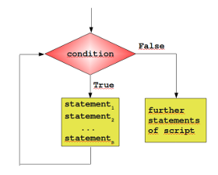
Python supplies two different kinds of loops: the while loop and the for loop, which correspond to the condition-controlled loop and collection-controlled loop.
Most loops contain a counter or more generally variables, which change their values in the course of calculation. These variables have to be initialized before the loop is started. The counter or other variables, which can be altered in the body of the loop, are contained in the condition. Before the body of the loop is executed, the condition is evaluated. If it evaluates to False, the while loop is finished. This means that the program flow will continue with the first statement after the while statement, i.e. on the same indentation level as the while loop. If the condition is evaluated to True, the body, - the indented block below the line with "while" - gets executed. After the body is finished, the condition will be evaluated again. The body of the loop will be executed as long as the condition yields True

Slide 28
A Simple Example with a While Loop
It's best to illustrate the operating principle of a loop with a simple Python example. The following small script calculates the sum of the numbers from 1 to 100. We will later introduce a more elegant way to do it.
#!/usr/bin/env python3
n = 100
s = 0
counter = 1
while counter <= n:
s = s + counter
counter += 1
print("Sum of 1 until %d: %d" % (n,s))

Slide 29
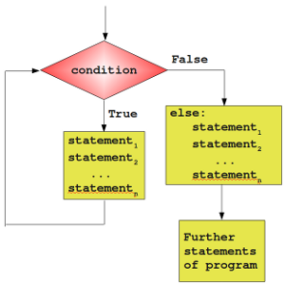
The else Part
Similar to the if statement, the while loop of Python has also an optional else part. This is an unfamiliar construct for many programmers of traditional programming languages. The statements in the else part are executed, when the condition is not fulfilled anymore. Some might ask themselves now, where the possible benefit of this extra branch is. If the statements of the additional else part were placed right after the while loop without an else, they would have been executed anyway, wouldn't they. We need to understand a new language construct, i.e. the break statement, to obtain a benefit from the additional else branch of the while loop.

Slide 30
For Loops
Different kinds of for loops:
• Count-controlled for loop (Three-expression for loop)
This is by far the most common type. This statement is the one used by C. The header of this kind of for loop consists of a three-parameter loop control expression. Generally it has the form:
for (A; Z; I)
A is the initialisation part, Z determines a termination expression and I is the counting expression, where the loop variable is incremented or dcremented. An example of this kind of loop is the for-loop of the programming language C:
for (i=0; i <= n; i++)
This kind of for loop is not implemented in Python!
• Numeric Ranges
This kind of for loop is a simplification of the previous kind. It's a counting or enumerating loop. Starting with a start value and counting up to an end value, like for i = 1 to 100
Python doesn't use this either.
• Vectorized for loops
They behave as if all iterations are executed in parallel. This means, for example, that all expressions on the right side of assignment statements get evaluated before the assignments.
• Iterator-based for loop
Finally, we come to the one used by Python. This kind of a for loop iterates over an enumeration of a set of items. It is usually characterized by the use of an implicit or explicit iterator. In each iteration step a loop variable is set to a value in a sequence or other data collection. This kind of for loop is known in most Unix and Linux shells and it is the one which is implemented in Python.

Slide 31
Syntax of the For Loop
edibles = ["ham", "spam", "eggs","nuts"]
for food in edibles:
if food == "spam":
print("No more spam please!")
continue
print("Great, delicious " + food)
# here can be the code for enjoying our food :-)
else:
print("I am so glad: No spam!")
print("Finally, I finished stuffing myself")
The output looks as follows:
$ python for.py
Great, delicious ham
No more spam please!
Great, delicious eggs
Great, delicious nuts
I am so glad: No spam!
Finally, I finished stuffing myself
$
for <variable> in <sequence>:
<statements>
else:
<statements>

